Slide 1
KEYLOGGER PROJECT
CAPSTONE PROJECT
Presented By:
Student Name: DEEPAK S
College Name: KINGS ENGINEERING COLLEGE
Department : COMPUTER SCIENCE & ENGINEERING

Slide 2
OUTLINE
Problem Statement (Should not include solution)
Proposed System/Solution
System Development Approach (Technology Used)
Algorithm & Deployment
Result (Output Image)
Conclusion
Future Scope
References

Slide 3
Problem Statement
In today's digital age, where cybersecurity threats loom large, one of the significant concerns is the proliferation of keyloggers, stealthy software tools designed to monitor and record keystrokes on a user's computer without their knowledge. Keyloggers pose a severe threat to individuals and organizations as they can capture sensitive information such as passwords, credit card details, and other personal data, leading to identity theft, financial loss, and privacy breaches.

Slide 4
Proposed Solution
Data Collection:
Gather data on keypress events, including timestamps and types of keys pressed.
Optionally, collect additional contextual data such as application usage, user activity, and system events.
Data Preprocessing:
Clean and preprocess the collected data to handle any anomalies or inconsistencies.
Perform feature extraction to derive meaningful insights from the raw keypress data, such as frequency of specific key usage or patterns in typing behavior.
Machine Learning Algorithm:
Implement machine learning techniques to analyze the keypress data and identify patterns or anomalies.
Consider using algorithms such as anomaly detection, clustering, or classification to detect suspicious or unusual typing behavior.
Deployment:
Develop a user-friendly interface or dashboard for monitoring and analyzing keylogging data.
Ensure the deployment platform provides secure access controls and encryption mechanisms to protect sensitive user information.
Evaluation:
Evaluate the performance of the keylogger system based on metrics such as detection accuracy, false positive rate, and system resource usage.
Continuously monitor and update the keylogger system to adapt to evolving typing patterns and security threats.

Slide 5
System Approach
Data Collection:
Ability to capture keypress events, including timestamps and types of keys pressed.
Optional collection of additional contextual data such as application usage, user activity, and system events.
Data Processing:
Processing power sufficient to handle real-time data collection and preprocessing.
Efficient algorithms for cleaning and preprocessing the collected data to handle anomalies or inconsistencies.
Adequate storage capacity to store keylogging data securely.
Machine Learning:
Access to machine learning libraries for implementing algorithms to analyze keypress data.
Resources for model training, evaluation, and optimization.

Slide 6
Algorithm & Deployment
Algorithm Selection:
The chosen algorithm for detecting anomalous keylogging behavior is an anomaly detection algorithm. Anomaly detection is well-suited for identifying unusual patterns or outliers in data, which aligns with the objective of detecting suspicious or unauthorized keyboard activity.
Data Input:
The algorithm utilizes the following input features:
Timestamps: Capturing the time of keypress events to analyze temporal patterns.
Key types: Identifying the specific keys pressed to detect unusual typing behavior.
Training Process:
The algorithm is trained using historical keylogging data containing both normal and anomalous keypress patterns.
During training, the algorithm learns to distinguish between normal typing behavior and anomalous events by identifying patterns in the input features
Prediction Process:
Once trained, the algorithm can make predictions for future keylogging events in real-time.
During the prediction phase, the algorithm analyzes incoming keypress data and compares it against the learned patterns from the training phase.

Slide 7

OUTPUT:

Slide 8
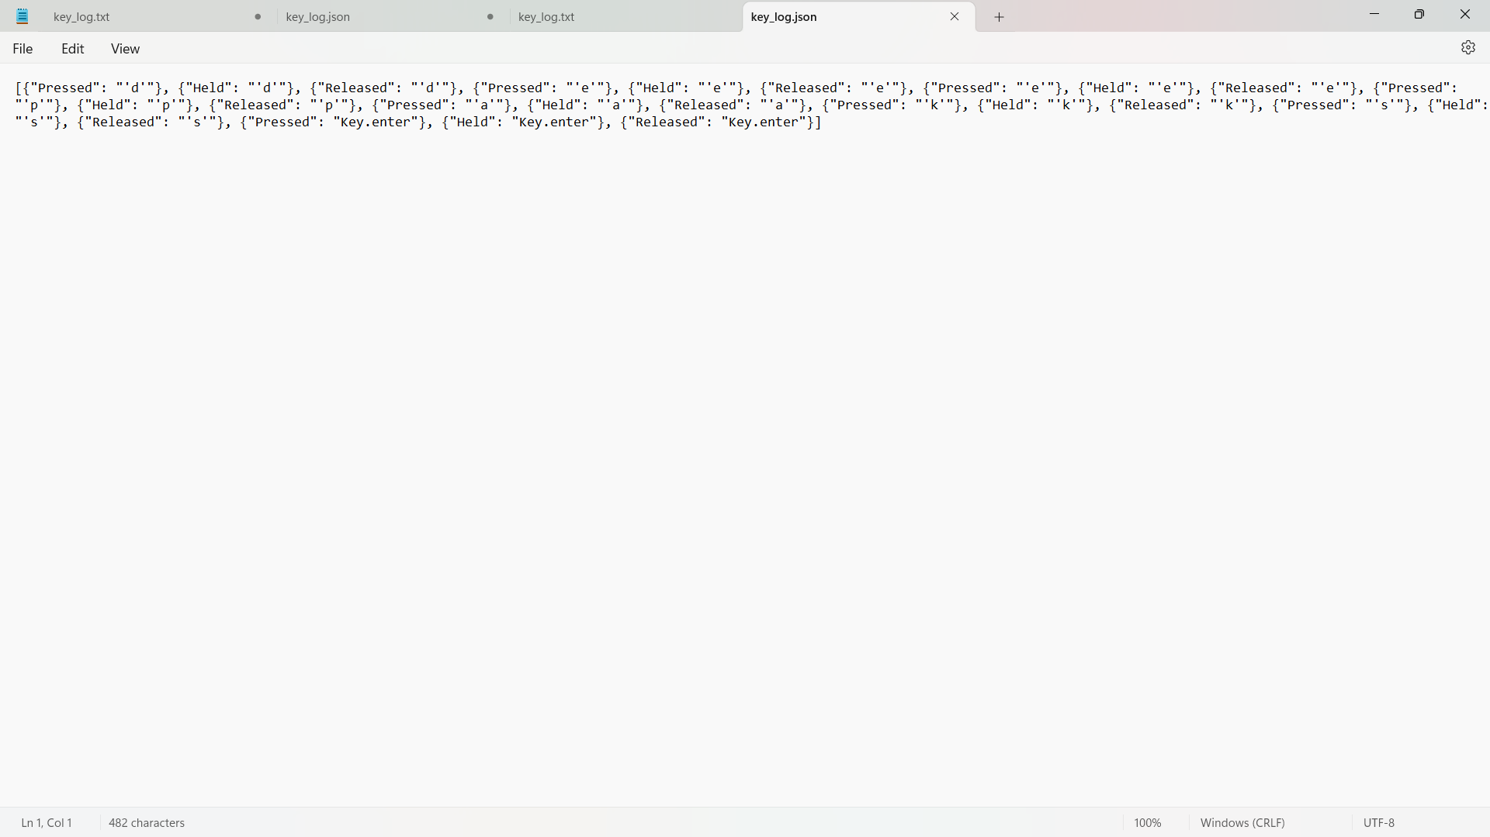
Result

Slide 9
Conclusion
In conclusion, the development of a keylogger system presents a robust solution for monitoring and analyzing keyboard activity, with a focus on security and anomaly detection. By leveraging advanced techniques in data collection, preprocessing, and machine learning, the system can effectively detect and respond to suspicious or unauthorized keylogging behavior in real-time

Slide 10
Future scope
Advanced Anomaly Detection Techniques: Explore and implement more sophisticated anomaly detection algorithms or machine learning models to improve the accuracy of detecting unusual typing behavior. This could involve deep learning approaches or ensemble methods to capture subtle patterns and anomalies more effectively.
Behavioral Biometrics Integration: Integrate behavioral biometrics, such as keystroke dynamics or typing rhythm analysis, to further enhance user authentication and detection capabilities. By incorporating individual typing patterns unique to each user, the system can better distinguish between authorized and unauthorized keyboard activity.
Dynamic Adaptation and Learning: Develop mechanisms for the keylogger system to dynamically adapt and learn from new typing patterns over time. This could involve reinforcement learning techniques or adaptive algorithms that continuously update the model based on feedback and evolving user behavior.

Slide 11
References
Keyloggers are malicious software programs designed to covertly record keystrokes on a computer or mobile device. These clandestine tools capture all keyboard inputs, including passwords, credit card numbers, and sensitive information, without the user's knowledge. Keyloggers can be distributed through various means, such as phishing emails, infected attachments, or compromised websites. Once installed, they operate silently in the background, logging every keystroke and transmitting the data to a remote server controlled by the attacker. Cybercriminals exploit keyloggers for various nefarious purposes, including identity theft, financial fraud, and espionage. Notable examples of keyloggers include Zeus, SpyEye, and DarkComet. These malware strains have been implicated in numerous cyber attacks and data breaches worldwide. Organizations and individuals must deploy robust cybersecurity measures, such as antivirus software, firewalls, and regular system updates, to mitigate the risk posed by keyloggers and other forms of malware.

Slide 12
THANK YOU

